Slide 1
Inference of gene regulation functions from dynamic transcriptome data
Journal Club – 6/13/2024

Slide 2
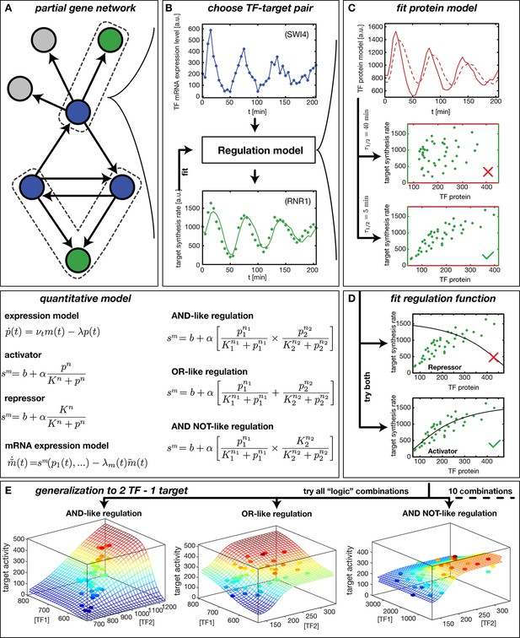
Fit regulation functions define TFs as activators or repressors based on mRNA expression level data of target gene fit to the target synthesis rate and plotted against TF protein model

Slide 3
Hill-functions can explain cases of combinatorial expression through matching the GRF to the model with the smallest variance to each logic combination

Slide 4
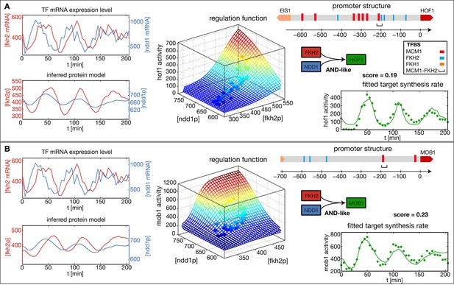
Inference method visualized with 2 target genes of the CLB2 cluster show that the inferred GRF mostly capture the expression dynamics of each gene

Slide 5
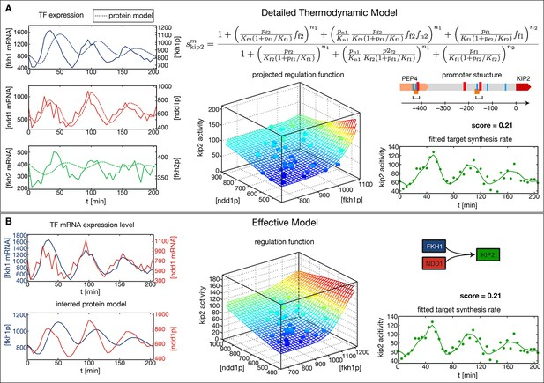
Kip2 regulation illustrated with the use of a thermodynamic model based on promoter structure (A) vs. general inference method (B) shows that the general inference method is a valid and can describe more complex GRFs

Slide 6
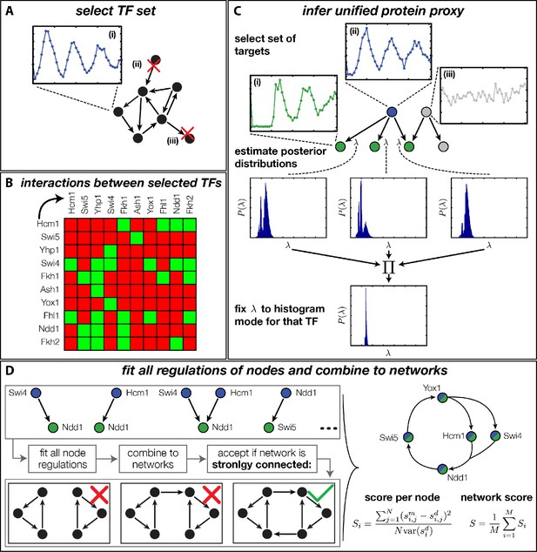
Stepwise approach to generating networks with global DTA data
TFs were selected based on criteria to ensure the resulting network was strongly connected
Gene interactions taken from literature where green squares indicate interactions between genes
Method to determine the protein degradation rate for each TF
Combine network and define based on connectedness and score -> network with the best score is most likely

Slide 7
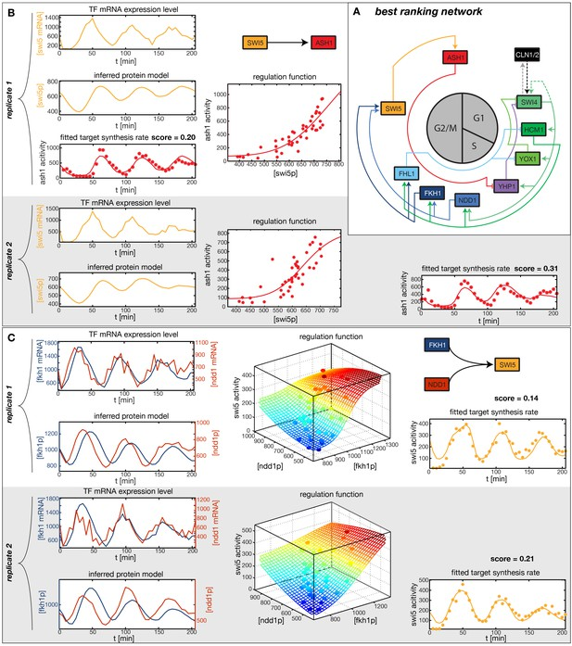
Best ranking network is similar to literature cited transcriptional oscillator networks

Slide 8
Analysis of Swi4 node from this network shows that this network is not autonomously regulated but is better defined with added inputs

Slide 9
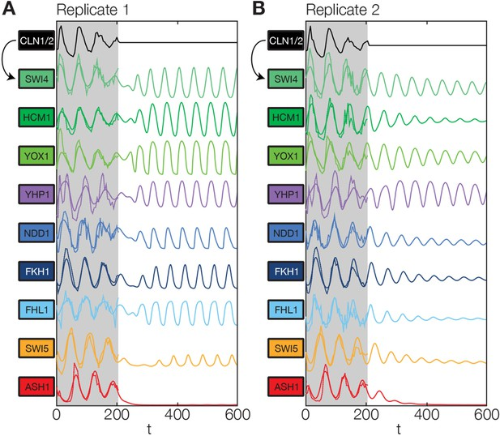
Model effectively describes aspects of cell cycle oscillations

